Slide 1
Book Pool Management
Mini-project Presentation

Slide 2
Index
Introduction – General idea of the Project
Objective and Aims
Why Django?
Features & Functionalities
Technology Platform
System Requirements
Challenges
What we have learned ?
Future Scope
Conclusion

Slide 3
General idea of the Project
The project titled Book Pool Management" is for monitoring and controlling the transaction of books of different users. It is a web application developed using Django, HTML and PostgreSQL which contains basic operations like adding new members, new book and updating new information, searching books ,sharing,
borrowing and peer to peer interaction.

Slide 4
Objective and Aims of the Project
Easily accessible to both beginners and advanced users due to an effective user interface.
User can see books uploaded by other users and the books requested by him/her.
A search column to search availability of books
Users have an option of accepting or declining a book request from other users.
Time Saving.
Peer to Peer interaction between users.
Blogs.
E-Books.
Communication between the users.

Slide 5
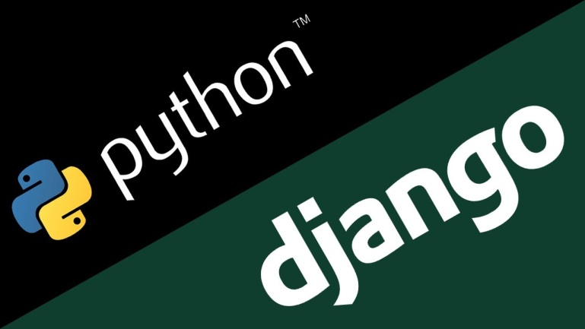
Why Django ?
Django is a high-level Python web framework that enables rapid development of secure and maintainable website
Written in Python
Accelerates custom web application development
Compatible with major operating systems and databases
Provides robust security features

Slide 6
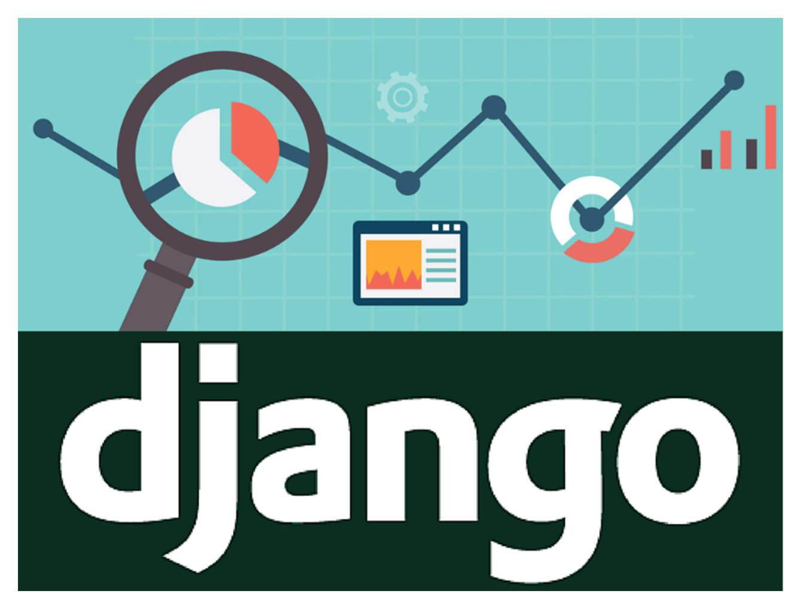
It can work with lots of different databases
Admin Panel in Django is Really helpful in many ways

Slide 7
DEMO – Part 1
Demo containing the Models ,Apps ,Views , Database connection and Admin Page of Django

Slide 8
Apps and Models in Django
Applications include some combination of models, views, templates, static files, URLs, etc. They’re generally wired into projects with the INSTALLED_APPS setting and optionally with other mechanisms.
It is important to understand that a Django application is a set of code that interacts with various parts of the framework. There’s no such thing as an Application object. However, there’s a few places where Django needs to interact with installed applications, mainly for configuration.

Slide 9
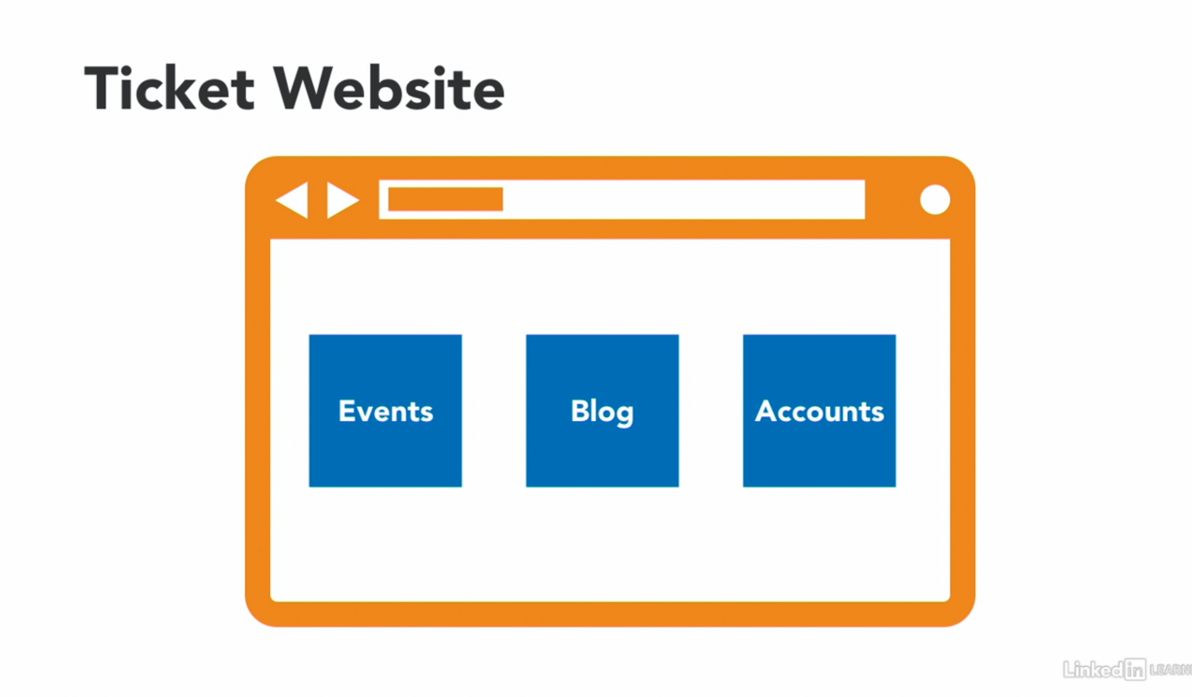
Example for Apps in a Website

Slide 10
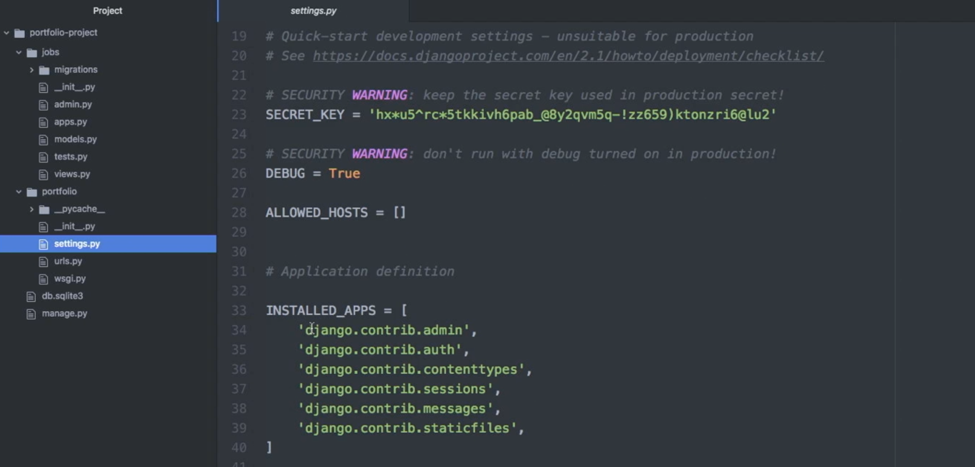
Default Apps in Django

Slide 11
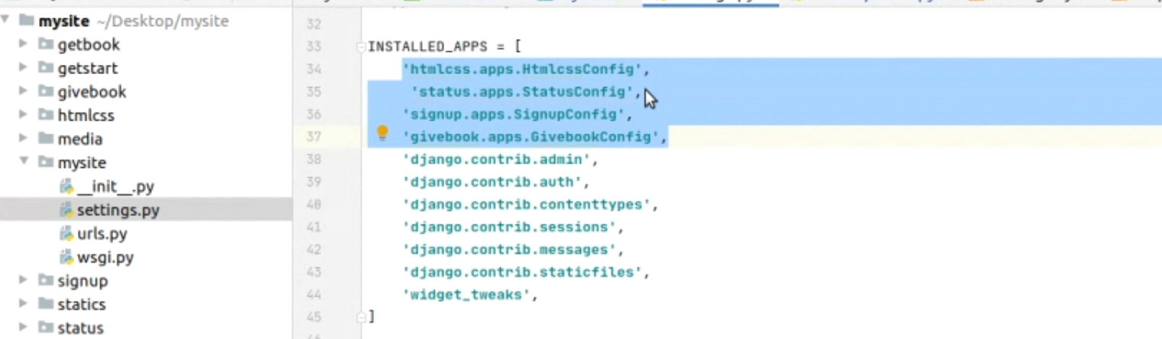
Apps that are build for the Project

Slide 12
Models & Views in Django
A model is the single, definitive source of information about your data. It contains the essential fields and behaviors of the data you’re storing. Generally, each model maps to a single database table.
A view function, or view for short, is a Python function that takes a Web request and returns a Web response. This response can be the HTML contents of a Web page, or a redirect, or a 404 error, or an XML document, or an image . . . or anything, really. The view itself contains whatever arbitrary logic is necessary to return that response. This code can live anywhere you want, as long as it’s on your Python path.

Slide 13
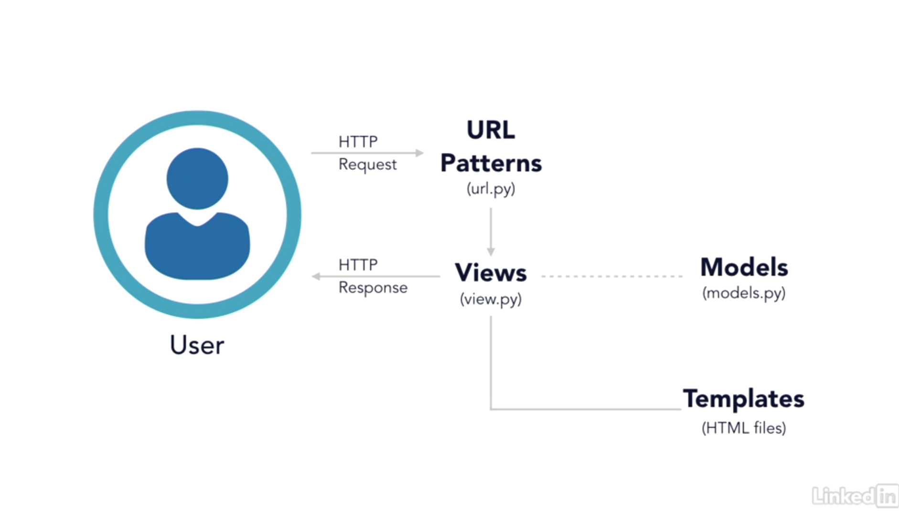

Slide 14
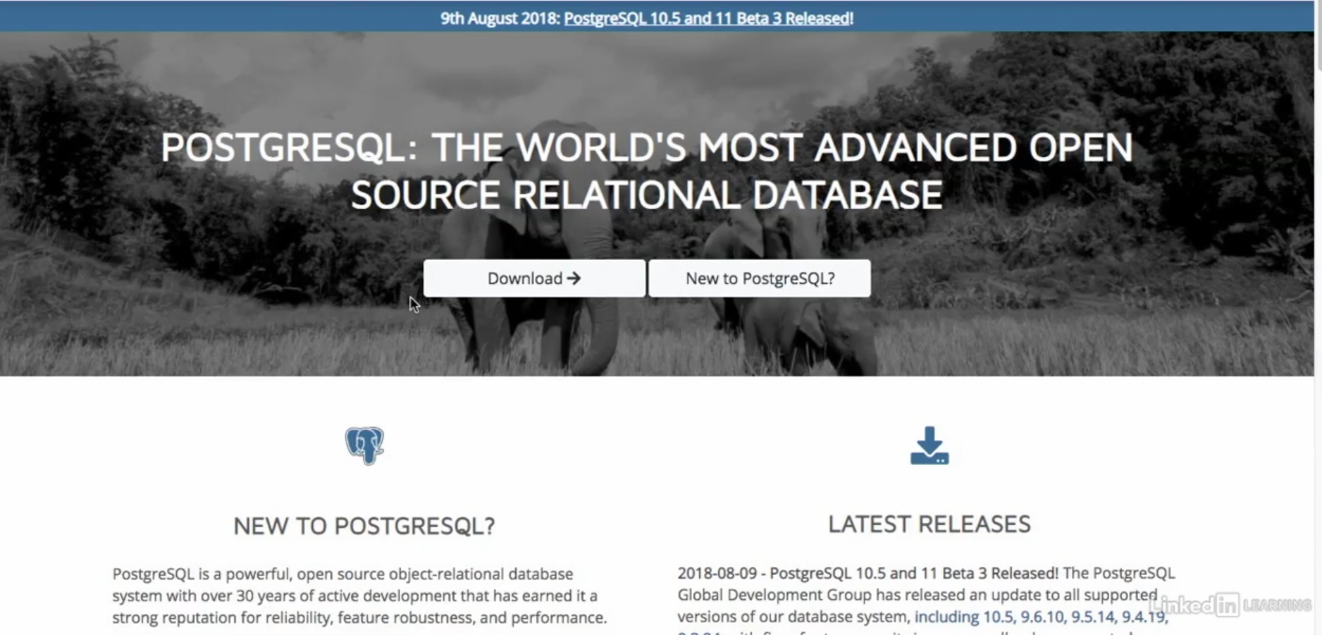
POSTgreSQL

Slide 15
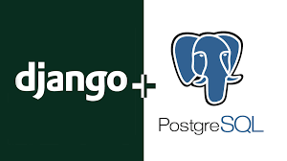
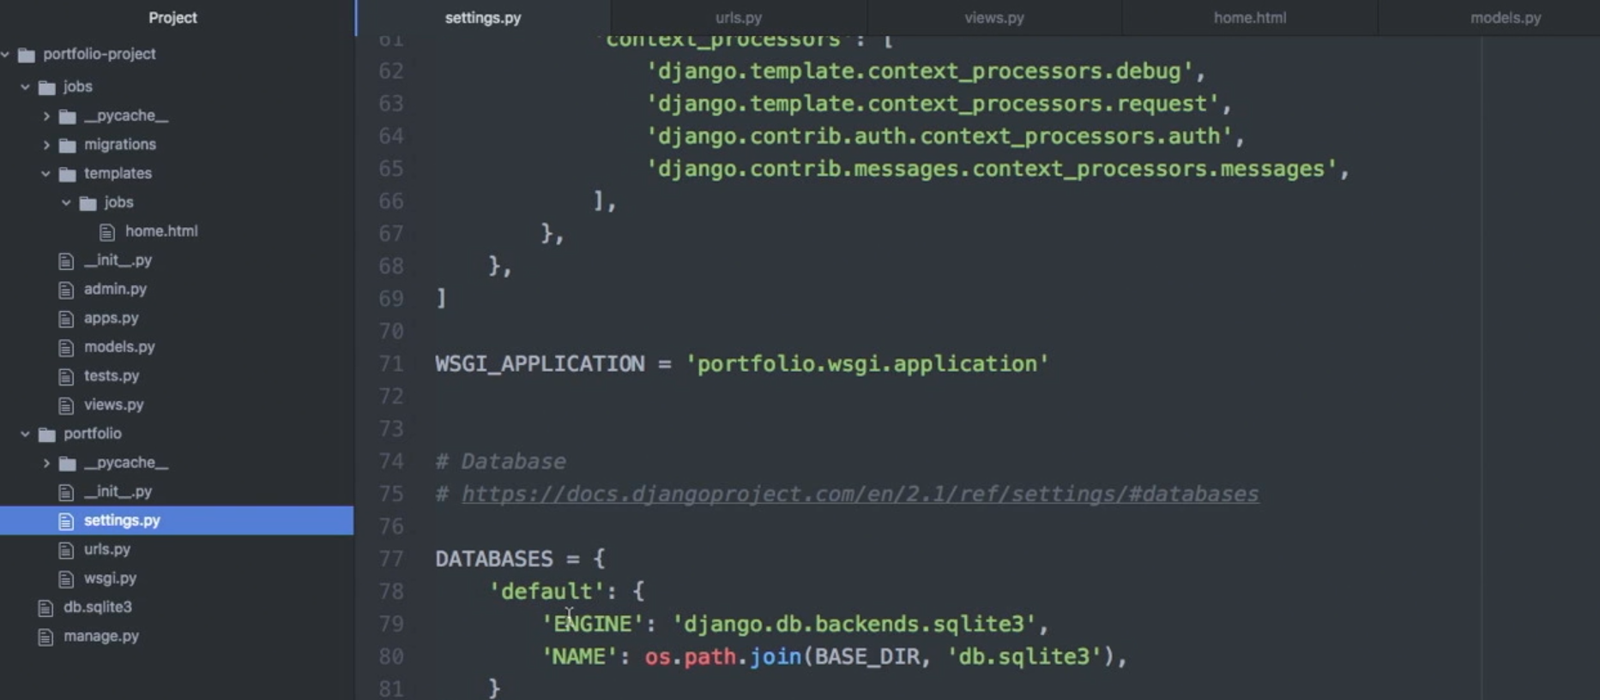

Slide 16
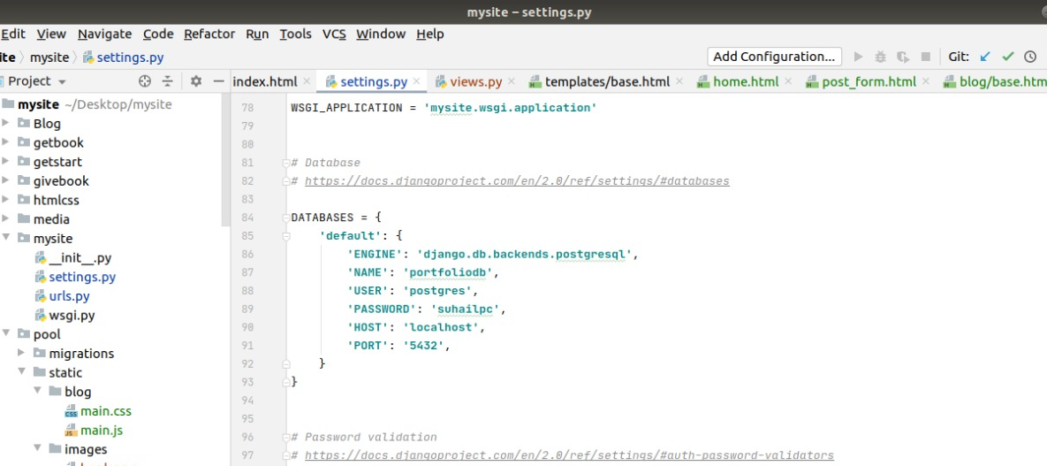
Connection of Database to Django

Slide 17
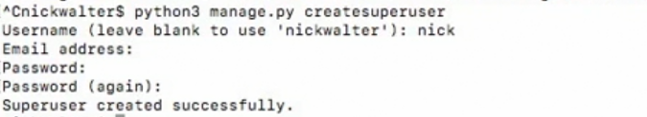
Setting up Admin Panel
One of the most powerful parts of Django is the automatic admin interface. It reads metadata from your models to provide a quick, model-centric interface where trusted users can manage content on your site. The admin’s recommended use is limited to an organization’s internal management tool. It’s not intended for building your entire front end around.

Slide 18
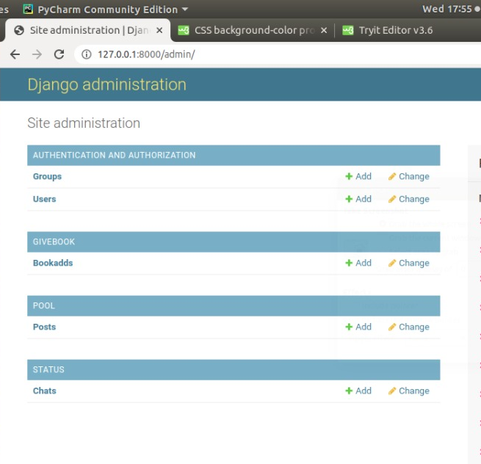
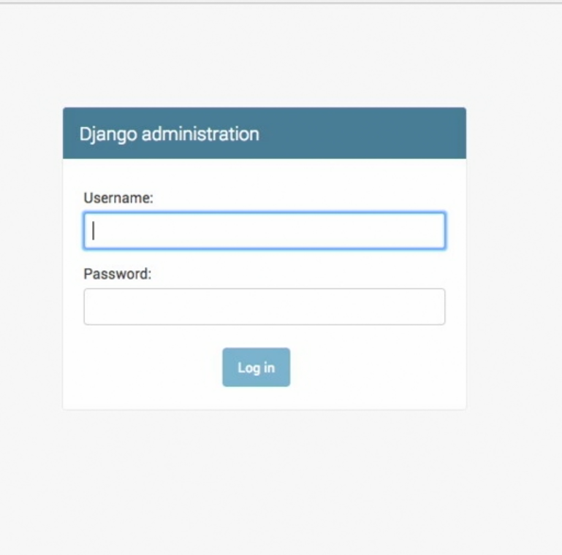
Admin Panel
Operations

Slide 19
Features and Functionalities
Get a Book
Share a Book
Chat with other users
Blogs

Slide 20
Get a Book
Variety of books to choose from
Search according to title, author, genre , language ,etc.
Select a book of your choice
Request It

Slide 21
Share a Book
Share the books that you have finished reading to other users
Input details such as Title author language etc
Click the upload button
Other users will request the book and you can accept or reject the request

Slide 22
Chat with Other Users
Interface for communicating with users with whom you are exchanging your books.
Decide the method for exchange of books.
Connect with other readers of same interests

Slide 23
Blogs
Read and learn through our blogs.
Blogs are updated regularly.
You can feature your writings by contacting us in the about us page

Slide 24
Advantages of Django
Django prides itself as a batteries-included framework.
Postgres special features with Postgres Package
Authentication with auth package.
Admin interfacing with admin package
Session management with Sessions package
Managing temporary or session-based messages with Messages package

Slide 25
2. Django is one of the web frameworks which are written in Python programming language.
Easier for programmers to build web applications with clean, readable, and maintainable code by taking advantage of syntax rules of Python.
Developers can easily curtail the development time by building custom web applications without writing additional code.
3. Provides robust security features.
The built-in security features provided by Django help developers to protect the web applications from a variety of targeted security attacks – cross-site scripting, SQL injection and cross-site request forgery
Web framework enhances the security of web applications by preventing common security mistakes related to Python coding.

Slide 26
4. Easy to extend and Scale.
Developers can easily customize, scale, and extend the web framework by making changes to its decoupled components.
They even have option to unplug or replace these decoupled components according to precise requirements of individual projects
They can accelerate development of large and complex web applications by wiring up a wide range of components.
5.Supported by a large and active community. Provides robust security features.
The members of the Django community update new plug-ins and code snippets regularly to simplify web application development
The members of the community even help developers to resolve common web application development issues and problems.

Slide 27
6.Compatible with major operating systems and databases
Django enhances the accessibility of web applications by supporting major operating systems like Windows, Linux and MacOS.
The ORM system provided by Django makes it easier for programmers to work with several widely used databases.
They can even use the ORM system to perform common database operations and migrate from one database to another without writing additional code.

Slide 28
Future Scope
Recommendation system for users to select book.
SMS & E-mail alert system for each message and transaction.
An Educational platform for to share documents can be modified into a social media & connect accounts with Gmail, Facebook, etc.
Ecommercial site with delivery system.

Slide 29
Academic Outcomes
Familiar with production of a web application.
Planning and Execution.
Learned new platforms like Django, Postgres, Javascript, etc..
learned new tools like Pycharm, Pgadmin utilized open sources like Github, stackoverflow and bootstrap.

Slide 30
Conclusion
Book Pool Management is a dynamic website where customers can borrow used books online, through this website the customers can search for a book by its title, author or language.

